Slide 1
AUTOMATED TESTING WITH PYTHON
CODE EXPLORERS CLUB - 28/3/2024

Slide 2
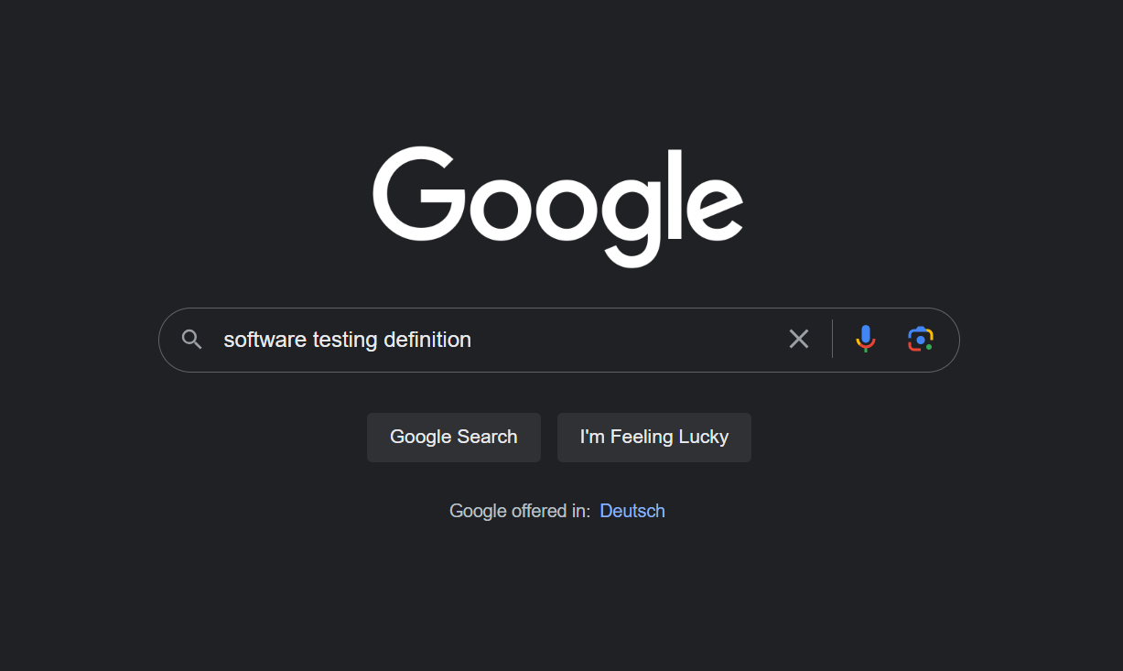
What is Testing?
“Process of checking the evaluating and verifying that a software or application does what it is supposed to do” IBM
“Examining the artifacts and behavior of the software under test by verification and validation” Wikipedia

Slide 3
What is Testing?
“Process of checking the evaluating and verifying that a software or application does what it is supposed to do” IBM
“Examining the artifacts and behavior of the software under test by verification and validation” Wikipedia
Testing is a process of finding errors in your software

Slide 4

Why Test?
Costs of less thorough testing can be higher than expected.
Quality assurance
Easier to add new features without breaking existing code
Mariner 1 (Credit: Nasa)

Slide 5
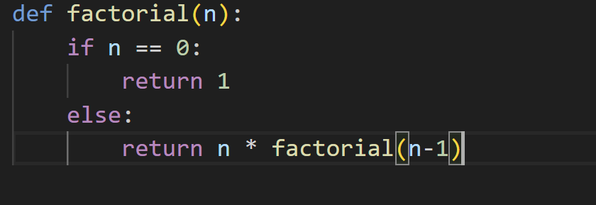
Manual Testing
Involves a human actively engaging with the software to identify errors without using any automated tools
manual_testing.py

Slide 6
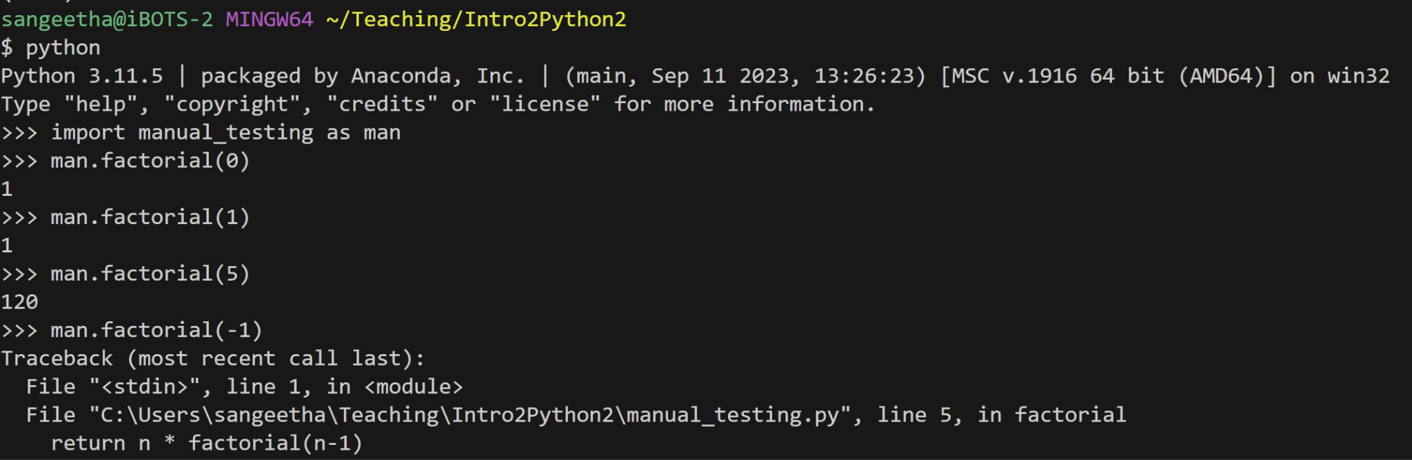
Manual Testing
manual_testing.py

Slide 7
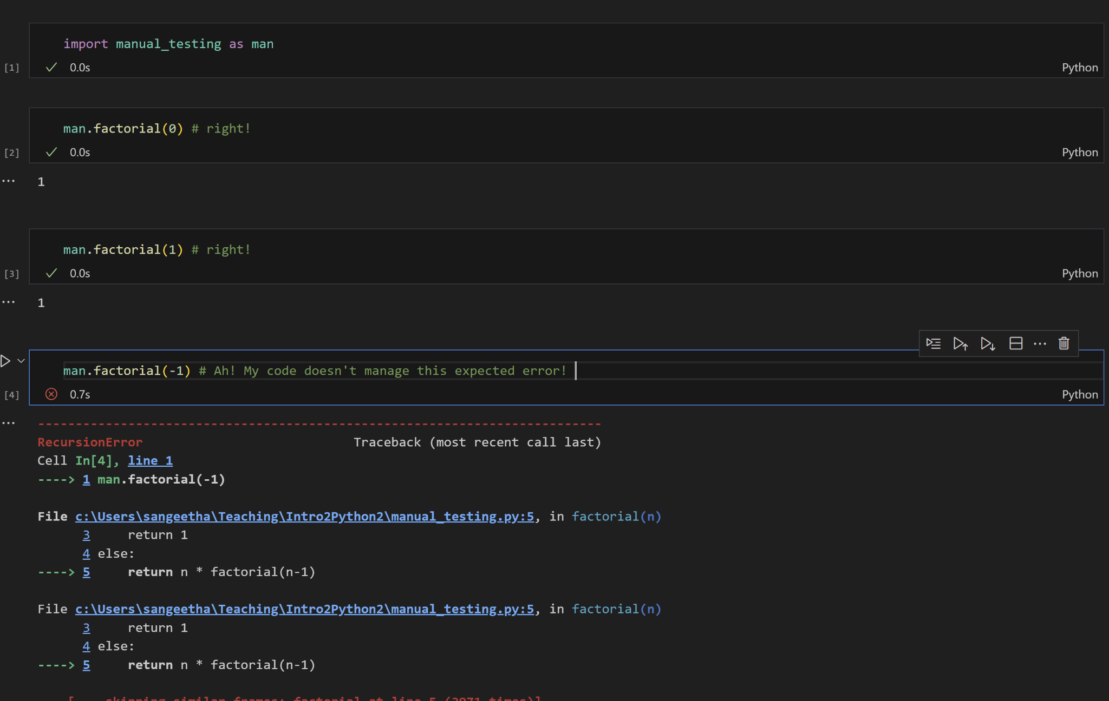
Manual Testing

Slide 8
Automated Testing
Instead of a human, we make use of automated tools and scripts

Slide 9
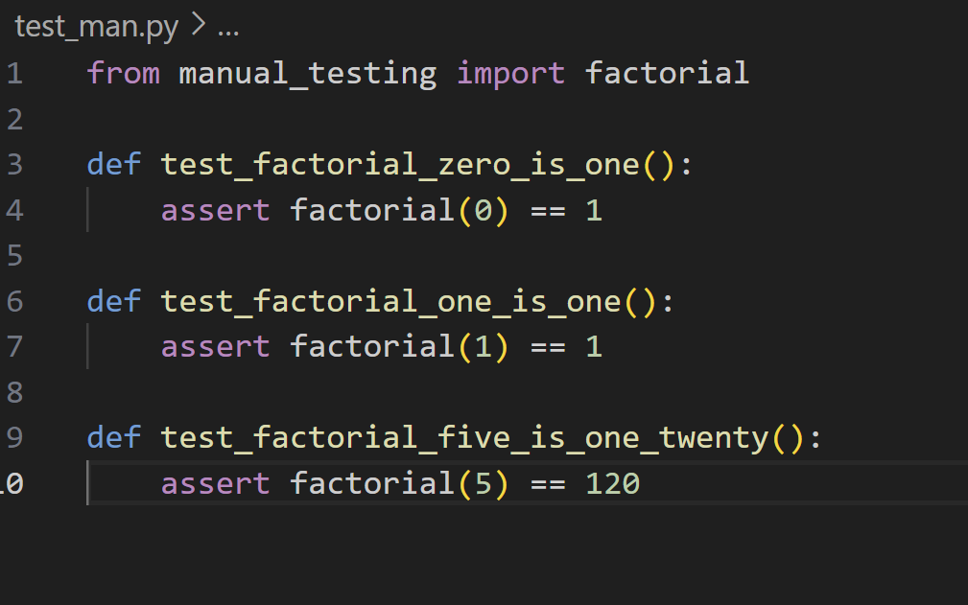
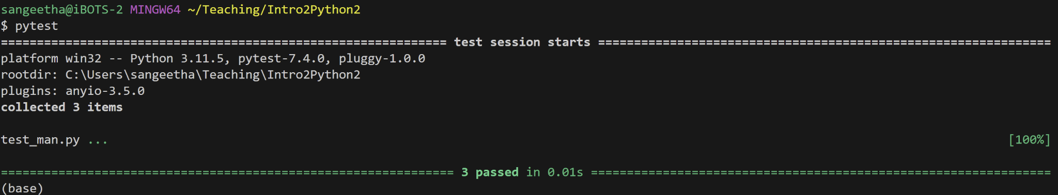
Automated Testing
Pytest

Slide 10
Levels of Testing
Unit testing: Testing individual components or functions of the software in isolation to ensure they perform as intended
Integration Testing: Testing the interaction between integrated units or components to verify they work together as expected
End-To-End Testing: Assessing the entire application, from start to finish, to ensure the flow of the software operates correctly in a real-world scenario

